Slide 1
Convertible Bonds and Short and Medium Term Debt and Coursework
Helena Pinto

Slide 2
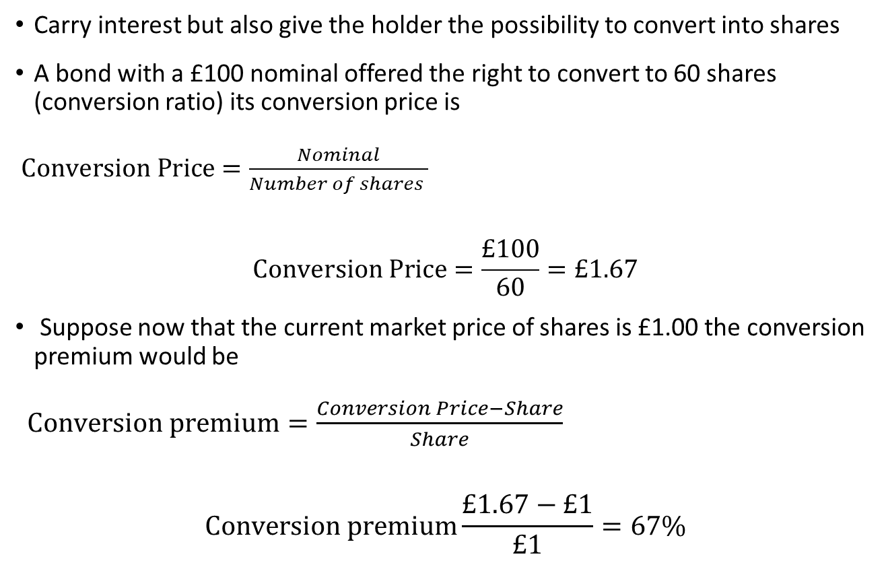
Convertible Bonds
Carry interest but also give the holder the possibility to convert into shares
A bond with a £100 nominal offered the right to convert to 60 shares (conversion ratio) its conversion price is
$Conversion Price=\frac{Nominal}{Number of shares }$
$$Conversion Price=\frac{£100}{60}=£1.67$$
Suppose now that the current market price of shares is £1.00 the conversion premium would be
$Conversion premium=\frac{Conversion Price−Share}{Share}$
$$Conversion premium\frac{£1.67−£1}{£1}=67\%$$

Slide 3
Short Term Bank Loan
Loan for a fixed amount and specific period
Traditionally has covenants

Slide 4
Overdraft
Overdraft authorization to overdraw on an account up to a stated limit
Advantages of overdraft
Interest is only paid in overdraft (cheap)
flexible from customer
Advantages of short-term loan
Clear payment schedule and terms of agreement
Lower interest rate
No risk of withdraw at short notice
May not have collateral

Slide 5
Trade credit
Simplest form of short-term finance
Goods or services are provided but only paid for, later
Advantages of trade credit
Convenient
Available to companies of any size
Disadvantages of trade credit
No discount

Slide 6
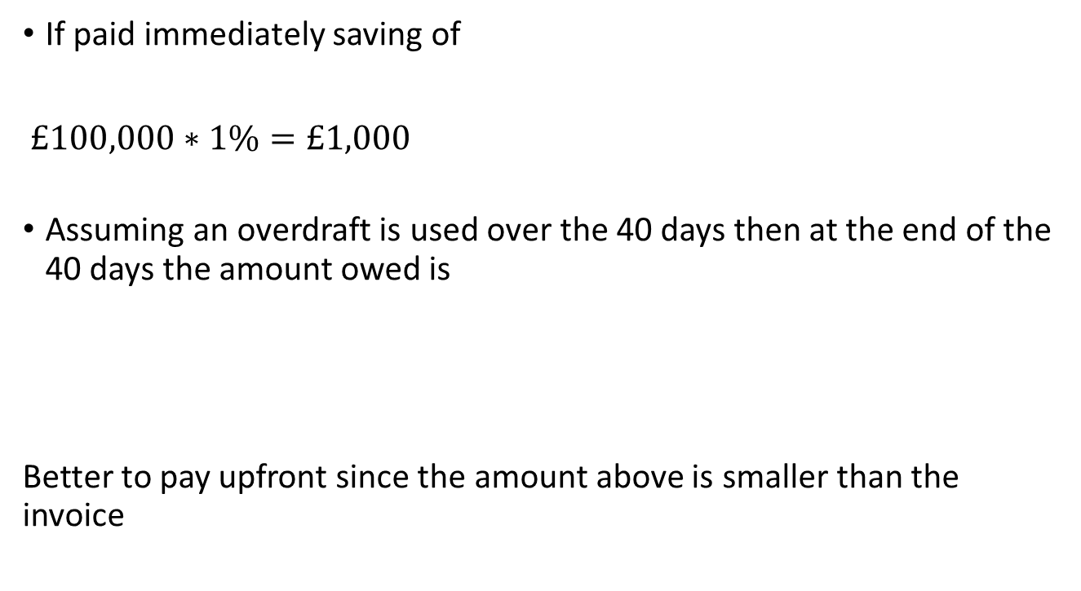
A company was invoiced £100,000 for some goods and has the following options available: Pay the invoice immediately and obtain a 1% discount Pay the full amount in 40 days Which is the better option if to pay immediately the invoice the company needs to use its overdraft account which has an APR of 6%.
If paid immediately saving of
$£100,000∗1\%=£1,000$
Assuming an overdraft is used over the 40 days then at the end of the 40 days the amount owed is
Better to pay upfront since the amount above is smaller than the invoice

Slide 7
Factoring
Factoring companies purchase trade receivables from companies.
Transfer cash (normally a percentage) to the receiving company with the promise that they will get their money back once the debtors pay.
Charge a fee and interest on the advanced money.

Slide 8
Factoring vs bank loans
Advantages
Can be organised quicker than a bank loan
No collateral
Disadvantages
Cost
Cannot factor small values

Slide 9
Bill of exchange
Bill is a document that promises to pay a specified amount of money
Cheque
Treasury-Bill (T-Bill)
Commercial-Bill
T- bills and Commercial bills can be sold in money markets
Generally, for 30; 60; 90 or 180 days.

Slide 10
Bankers Acceptances
The firm issues a document that states that a bank will make a certain payment in the future. The bank then accepts it.
Like a bill but now the bank (and not the firm) promises to pay.
Used as a payment of trade or sold in money markets.

Slide 11
Certificates of Deposit
Certificates of Deposit (CD)
pays interest and principal to the depositor only at maturity
Time deposit cannot be withdrawn on demand

Slide 12
Private Placement and Term Loan
There are 2 main types of private medium/long term loans: Private Placements and term loan
Private Placements- the sale of a loan or bond directly to a limited group of investors
Term loans are direct business loans, by banks, for a fixed amount and time with a specified repayment schedule for principal and interest payment.
May have a collateral
The big advantage is that the lender cannot ask for the repayment outside of the schedule (vs overdraft)

Slide 13
Syndicated Bank Loans
Some (large) banks have more demand for loans then what they can supply
Some banks arrange for a loan and then sell parts of it to a syndicate of other banks
Syndicated loan is a corporate loan made by a group of banks or other institutional investors

Slide 14
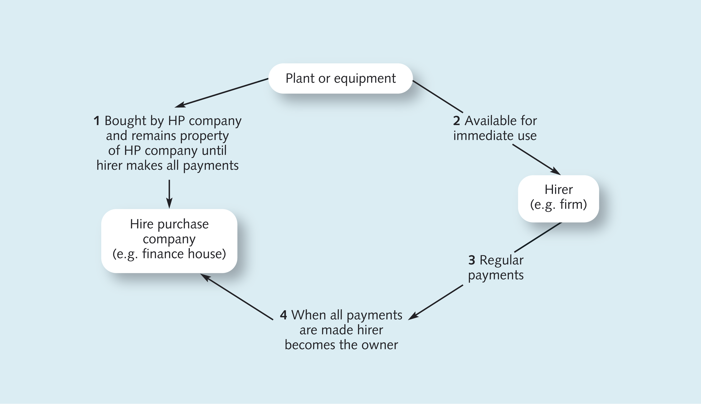
Hire Purchase

Slide 15
Advantages
Small initial outlay
Easy to arrange
Certainty
Often available when other sources are not
Fixed rate
Tax relief

Slide 16
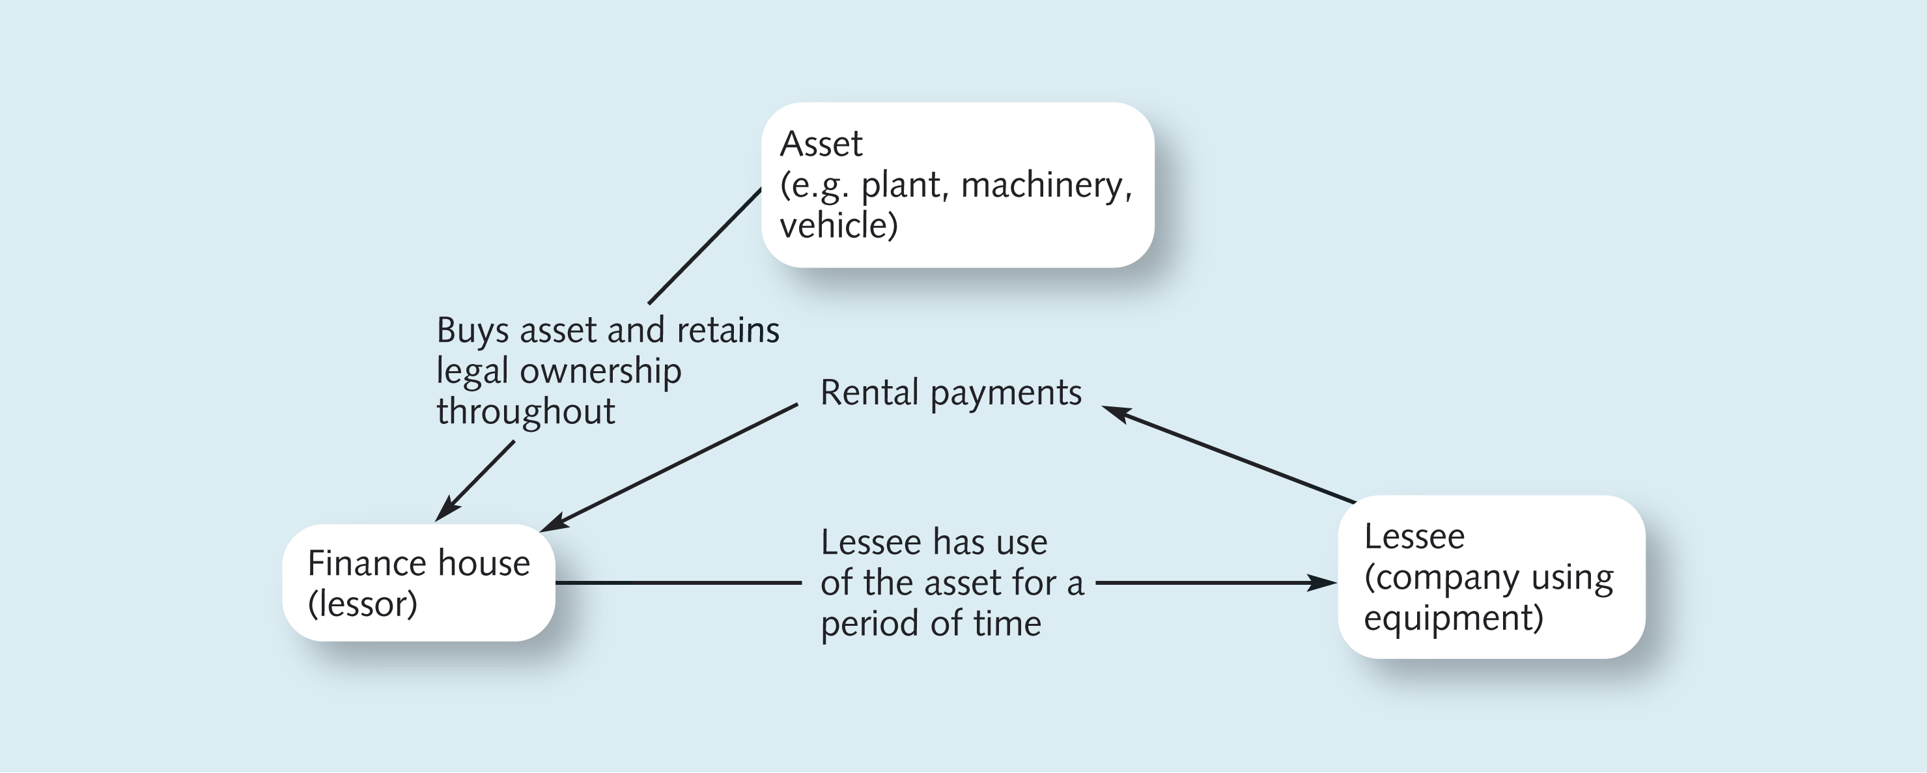
Leasing
The main difference with HP is that the lessee will not become the owner of the asset (but possible)

Slide 17
Advantages of leasing
Same as for HP
Small initial outlay
Easy to arrange
Certainty
Often available when other sources are not
Fixed rate
Tax relief
With added protection from the risk that the asset or equipment becomes obsolete.

Slide 18
Group Assignment

Slide 19
Details
30% Final mark
5 Students per group
1500 words does NOT include
- Appendices. These may be used to include supporting data, which may be too detailed or complex to include as a Table. They are not a device to incorporate material, which would otherwise cause you to exceed the word limit.
- Title page
- Contents page
- Abstract/executive summary
- Tables, figures, legends
- Reference lists
- Acknowledgements

Slide 20
Part 1
Ellie is considering doing an MSC 2 Universities
Stay in current job
“Great Thinking” 2 years; annual fees+ other costs. Once she finishes, she receives a job offer which gives her a salary until she retires + a bonus
“Great Prospects” 1 year; annual fees and other costs. Once she finishes, she gets a smaller salary and a bonus

Slide 21
Part 1
How does Ellie’s age affect her decision to do a master’s degree?
From a financial perspective and assuming all salaries are paid at the end of each year, should Ellie do an MSc and if so, which? Your answer should ignore tax considerations.
Ellie believes that the only correct method to support her decision is to calculate the future value of each option. How would you evaluate this statement?
Assume now that the new employers will not pay her a bonus; what initial salary would Ellie need to be offered by the new employers to make her indifferent between attending the University of Great Thinking or staying at her current job?

Slide 22
Part 2
You want to buy a house valued at £450,000 and you have a deposit of £100,000. Identify a fixed rate mortgage and a tracker rate mortgage and compare the 2 types of mortgage loans. Calculate the monthly repayments in each case, assuming you will have a 25-year mortgage loan. Comment on your findings and suggest reasons why people might choose tracker rate mortgages over fixed rate mortgages.

Slide 23
Mortgages Fixed/Tracker
Fixed just assume the rate over the 25 years
Note that to estimate the monthly payment for the tracker rate mortgage you will have to assume a specific pattern of change for the interest rate, a single increase on the interest rate on a specific year is enough for illustration. You are required to assume that the tracker rate will increase by 0.25% after 2 years and stay at a fixed level from then onwards. For the fixed rate mortgage assume that the rate is constant over the 25 years. Clearly state in the answer the source of mortgage rates you are using.

Slide 24
Suppose that you have asked for a loan of £500 for 6 years and that the bank charges 2% in the 1st two years and 3% from there onwards. What is the value of the constant annual payment? (Payments are made at year end)
2%
3%

Slide 25
Question 2
Amortization table- you will need to submit the excel. BE SURE YOU SUBMIT ALL FILES AT THE SAME TIME ON THE VLE
Lifetime ISA
Protection to savings if financial institution defaults

Slide 26
Question 3
Bonds- Go to assessment folder (DOWLOAD THE FILE TO SEE ALL THE DATA)
Data
HPR
CY
Green Bonds/Covid

Slide 27
Question 4
Choose a listed company from the FTSE100 list or from the original country of one of the elements in your group. Download the company’s more recent annual report from its website (the annual report must be in English). From the annual report, identify the CEO and briefly explain its compensation package. Briefly explain the main principles behind agency theory and discuss how/if the CEO pay package is in line with the solutions proposed by that theory to mitigate agency conflicts. If needed, make any necessary recommendations on improvements to the CEO package. You are expected to provide academic references and evidence to support your answer.

Slide 28
Part 5
This part of the coursework requires individual work. As part of this module, you are requested to submit weekly reading assignments. There are 9 reading assignments. If you submit 65% of the reading assignments, you will be awarded 13 marks. Submissions below 65% will be adjusted by the proportion of total number of reading assignments submitted. As an example, a student that only submits 20% of the total reading assignments will be awarded 2.6 marks

Slide 29
Referencing
Reference your sources
WEEK 5 12th of March 9-10am ATTEND
At the end of the assignment have a reference list- only have in this list references which you refer to in the text
Google scholar makes finding academic literature (and citing it) very easy.
There are, for whatever reason, lots of different referencing systems.
In the Management School, we use Harvard referencing. Here’s the university guide to referencing.

Slide 30
Groups
Be sure you are in a group (check the group on the VLE)- MAX 5MIN 4 (below this random allocation)
Any questions just contact me
Swap?
If you are trying to reach out a member of the group with no success, contact me.
If someone in your group is not contributing keep evidence that you tried to contact them and let me know as soon as possible- they will be given a mark of 0!

Slide 31
Coursework
Submitted on the VLE (the link will be under assessment)
Only 1 submission per group (elect 1 person)
Be sure you submit before the deadline
Check the file you submitted (you can submit many times before the deadline)- but submit all files at the same time
EXPLAIN YOUR CALCULATIONS
TYPE ALL THE WORK! (also true for workings)
Be Sure you do the weekly reading assignments!

Slide 32
QUESTIONS????
Extra Exercise

Slide 33
Example
The quote for a BMW series 1 on the 4/07/2021 is £25,430. A HP agreement offers you credit against the payment of £583.26 per month over the next 48 months. Are they effectively charging an annual rate of 2.52%?

Slide 34

APR?
$$25430=583.26\left[\frac{1}{r}−\frac{1}{r{(1+r)}^{48}}\right]$$
Using trial and error or excel

Slide 35
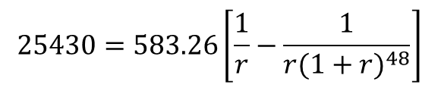
$$25430=583.26\left[\frac{1}{r}−\frac{1}{r{(1+r)}^{48}}\right]$$

Slide 36
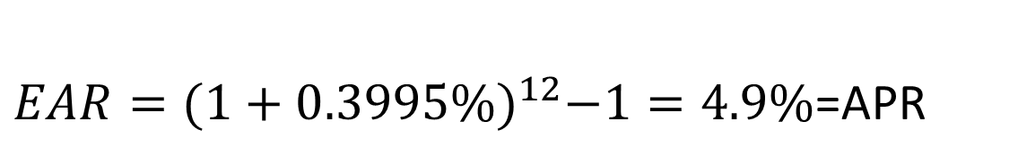
$EAR={(1+0.3995\%)}^{12}−1=4.9\%$=APR

Slide 37

Problem
What is the price of a 20 year 7% coupon bond (with semi-annual interest payments and a face value of £100) and a yield to maturity of 6%? Bonds pay simple interest and thus its rates are proportional (The coupon rate and yield are quoted in proportional terms and both rates are annual)
$$P_{0}=3.5\left[\frac{1}{3\%}−\frac{1}{3\%{(1+3\%)}^{40}}\right]+\frac{100}{{(1+3\%)}^{40}}=£111.557$$

